Slide 1
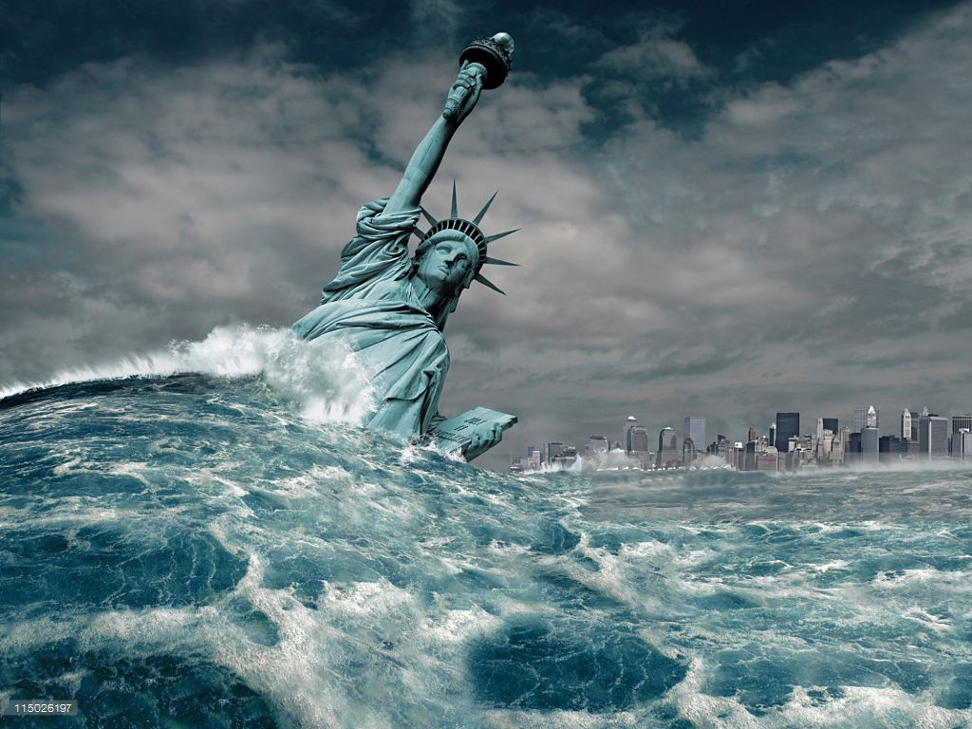
SEMINAR
Jammu and Kashmir floods 2014
a case study
BY Shah Fayiz Tariq
Student BE CIVIL
Enroll 4700

Slide 2
Outline
Introduction
Kashmir flood 2014
Affected areas
Casualties
Causes
Economic impacts
Sociological impacts
Impact on education sector
Rescue and relief operation
How to prevent such disaster in future
Conclusion

Slide 3
Introduction
Flood is overflow of excess water that submerges land and inflow of tide on to land
The European union(EU) floods Directive defines a flood as a covering by water of land not normally covered by water
Occurs when the geomorphic equilibrium in the river system is disturbed because of
intrinsic threshold
extrinsic threshold

Slide 4
Kashmir flood 2014
Time span-2-26 September 2014
AFFECTED AREAS:
INDIA, IOK,
PAKISTAN- POK, GILGIT BALTISTAN, PUNJAB
on 15 Sep 2014 river Jhelum in Srinagar was reported to be flowing at 22.40ft which was 4.4ft above the danger mark with discharge of 70000 cusecs. At Sangam in Anantnag the Jhelum was flowing at 36ft which is 15ft above danger mark with a discharge of 120000 cusecs.

Slide 5
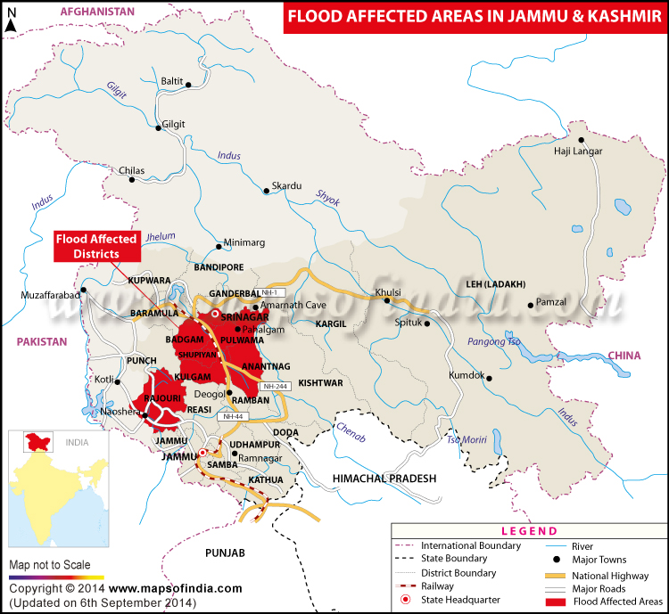

Slide 6
Cont…….
The Jhelum was flowing almost about 1m above its embankments in the stretch from Sangam to Kakapora for a distance of 25km on 6 to 7 Sep.
The river got swollen attaining a width of more than 2km at certain places in south Kashmir
Out of the 1760sq.km of flood plains, 912 sq.km were flooded in the Jhelum basin during 2014 floods

Slide 7
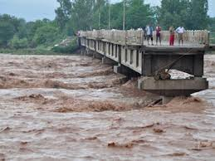
Casualties and property damage
DEATHS:-557
> 277 in Indian Occupied Kashmir
> 280 in Pakistan
PROPERTY DIAMAGE
> According to the sources, there was a total estimated loss of Rs 40,000 Crore to Kashmir division alone

Slide 8
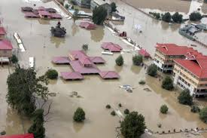
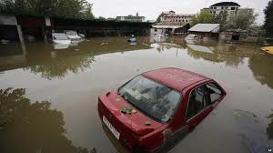
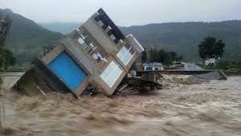

Slide 9
Causes
Climate change
Unplanned development on the banks of river Jhelum
Massive encroachments and erection of many structures along the river Jhelum which blocked the discharge channels of the river
Excessive siltation and pollution of the river Jhelum from the massive deforestation in its basin
Poor governance

Slide 10
Economic Impacts
Devastated vast stretches of world famous Kashmiri apple orchards
2600 villages where badly affected and 390 villages were submerged completely
15% of 201588 houses that 2011 census listed suffered damaged
The rise belt of Kashmir valley comprising of Anantnag and Kulgam were badly affected
The world famous saffron grown in Pampore experienced massive destruction
50 bridges were reported to have been damaged

Slide 11
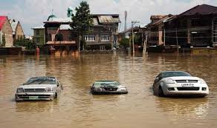
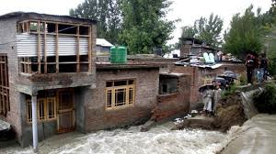
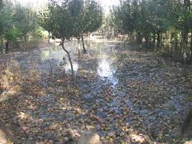

Slide 12
SOCIOLOGICAL IMPACTS
Increased level of trauma amongst the Kashmiri people
Overburden people with responsibilities of rebuilding their lives
Sense of loss and fear among children

Slide 13
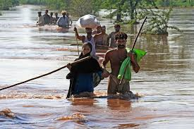
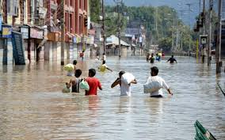
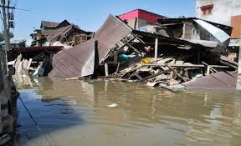

Slide 14
IMPACT ON THE EDUCATION SECTOR
Schools and other educational institutions remained closed till march 2015 leading to the loss of student population
Except 12th and 10th Classes all other classes till 11th were given mass promotion

Slide 15
RESCUE OPERATIONS AND RELIEF
Agencies involved:-
Civilians
The Indian Army
The Indian air Force
Teams from NDRF
Rescue operations were named as MISSION SAHIATA and operation MEGA RAHAT
Relief Fund:-
Rs 800 crore for flood relief to traders
Rs 2000 crore for re-building the damaged government infrastructure
Rs 400 crore for de siliting of jehlum
Rs 200 crore for reconstruction of bridges

Slide 16
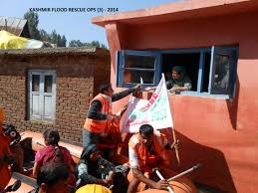
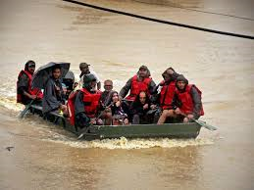

Slide 17
HOW TO PREVENT SUCH A DIASASTER IN FUTURE
Strengthening of embankments and bunds along Jehlum river and rivulets
Ban on construction of houses and infrastructure along the banks of Jehlum
De siltation and dredging of lakes and other water bodies
Ban on conversion of wet lands into built up and agricultural areas
Minimise deforestation
Construction of flood resistant structures
An alternative flood channels to be created which will run parallel to Jehlum

Slide 18

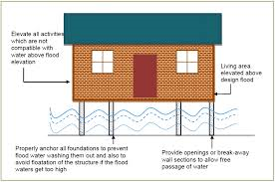


Slide 19
CONCLUSION
The floods of 2014 were warning by nature to Kashmiri’s not to mess with her lakes rivers forests and flood basins. This needs to be taken seriously so that a greater warning is not needed to jolt us out of our greed.

Slide 20
THANK YOU

